Slide 1


Inventory Management System
Dan Harrison

Slide 2


Content
The task
MVP
Project Management
Demonstration
Testing
Issues
Future Development

Slide 3
The Task
Create an Inventory Management System based on starter code given, with basic functionality to allow a business to manage their Customers, Items, and any Orders.

Slide 4
MVP
Full CRUD functionality for Orders, Items, and Customers
JDBC Connection with tables to store all information
Usable from Command Line

Slide 5
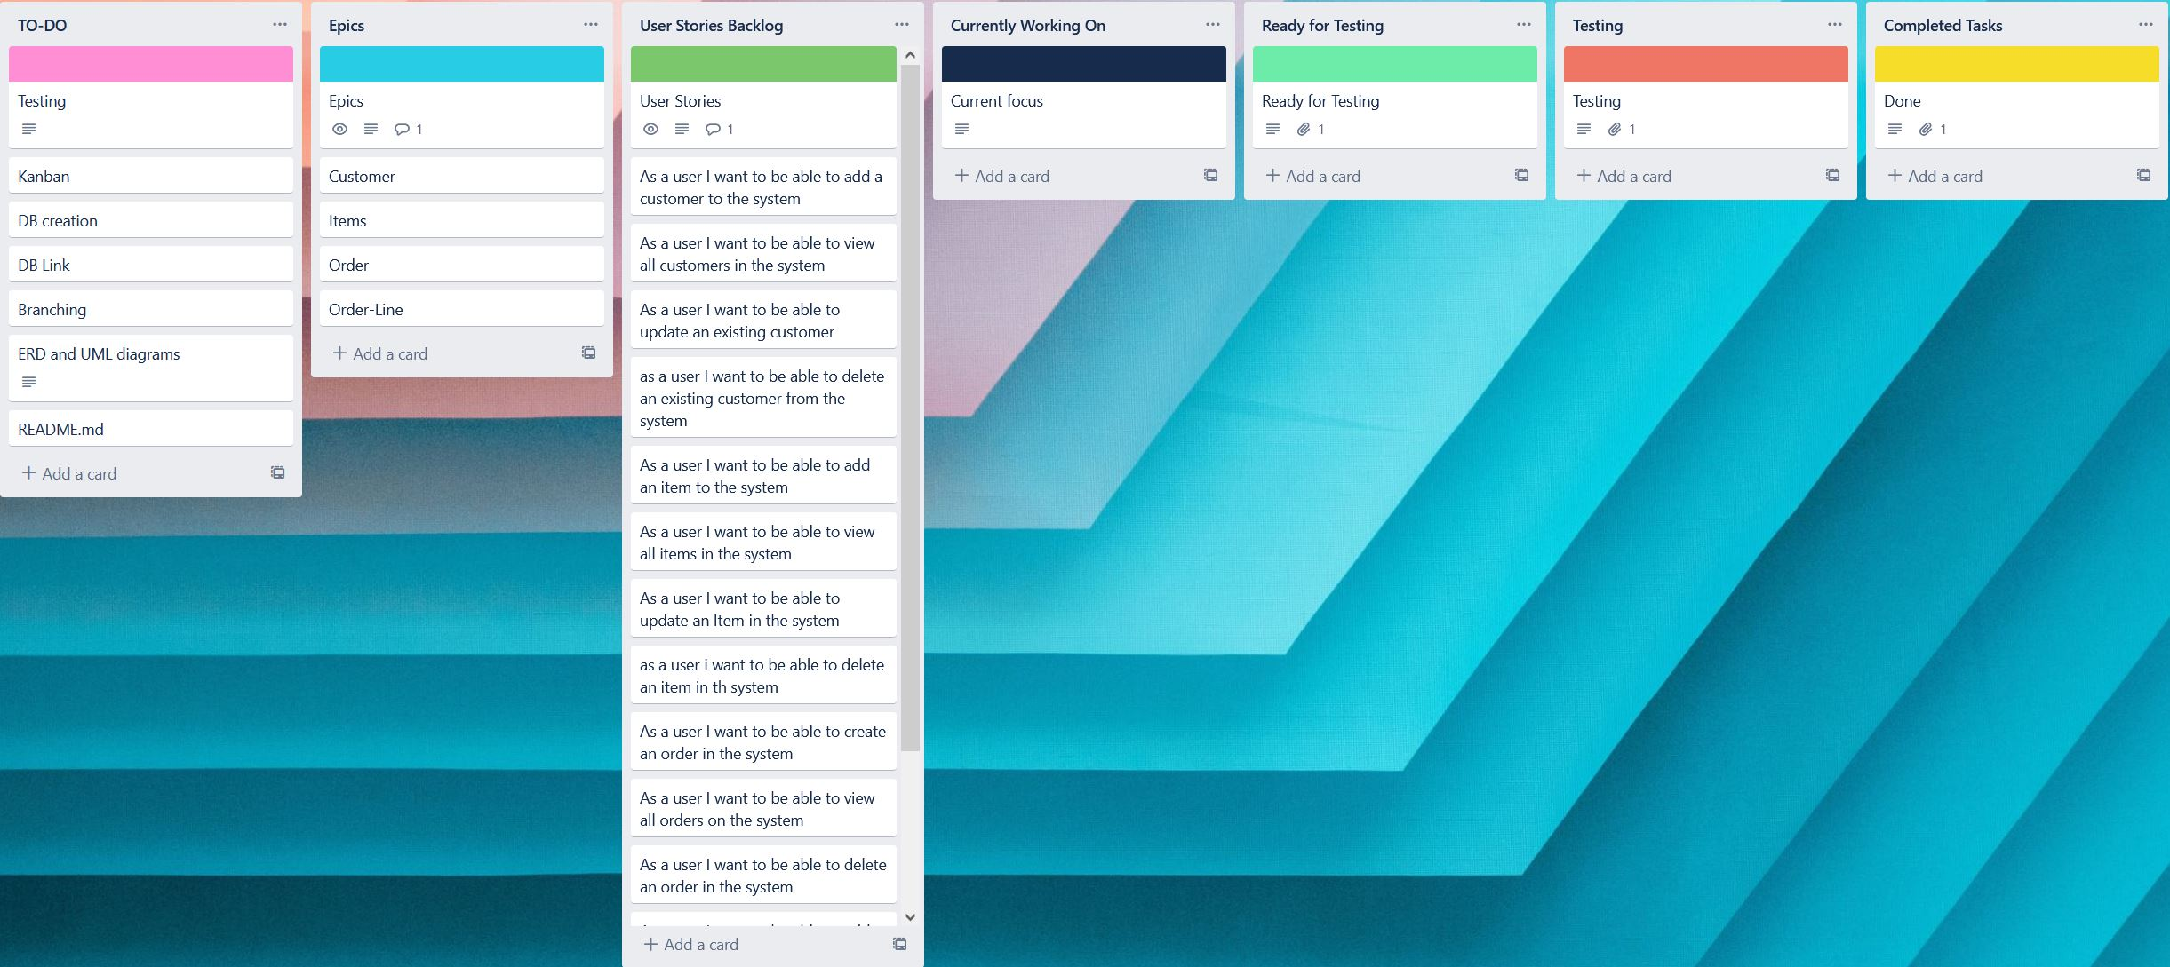
Project Management
Kanban Board – Trello

Slide 6
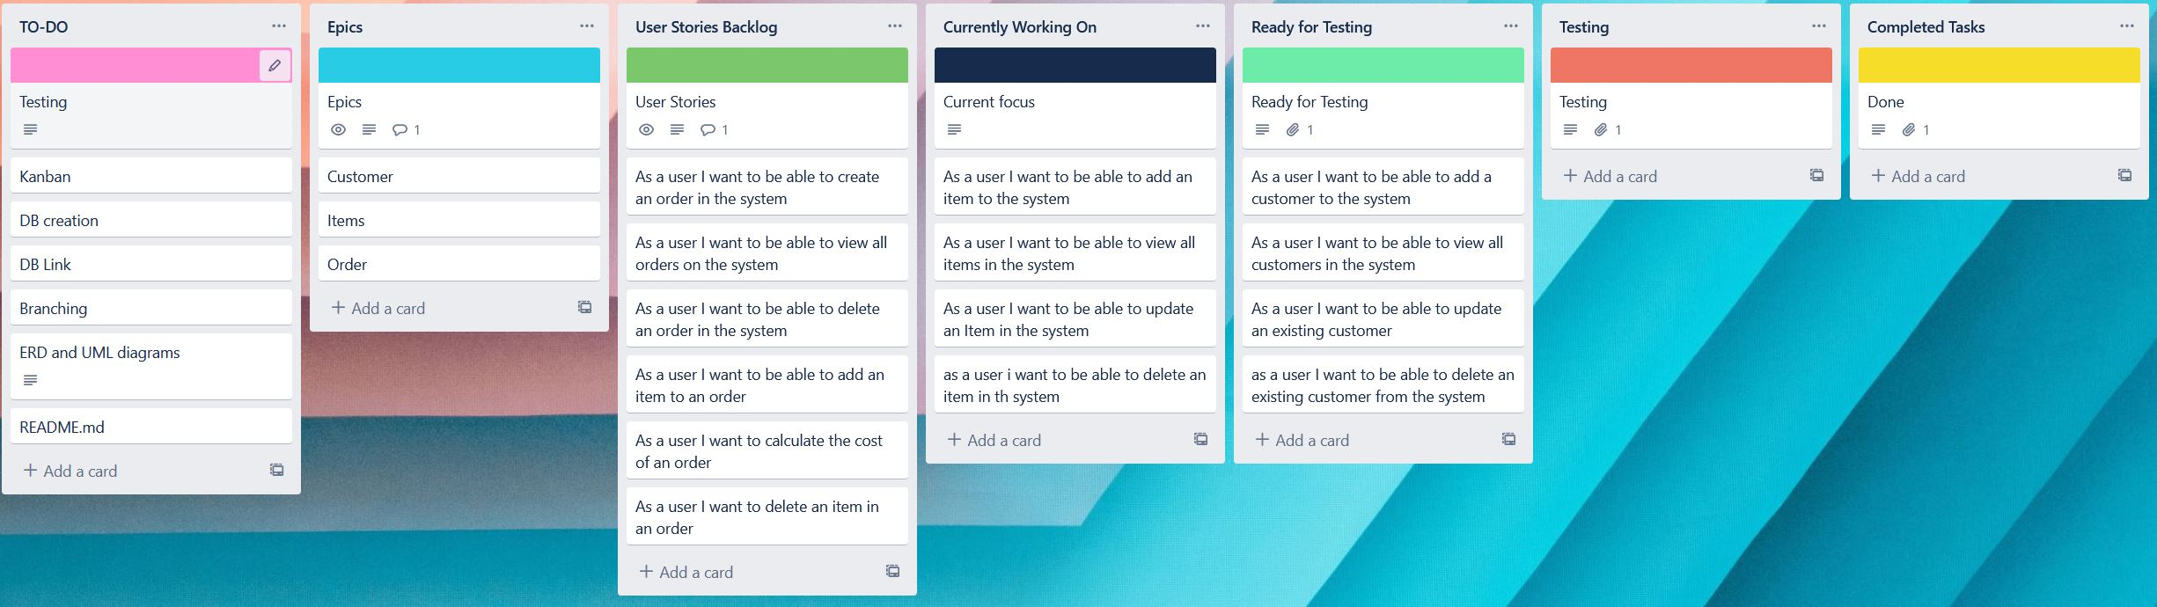
Project Management
Kanban Board – Trello

Slide 7
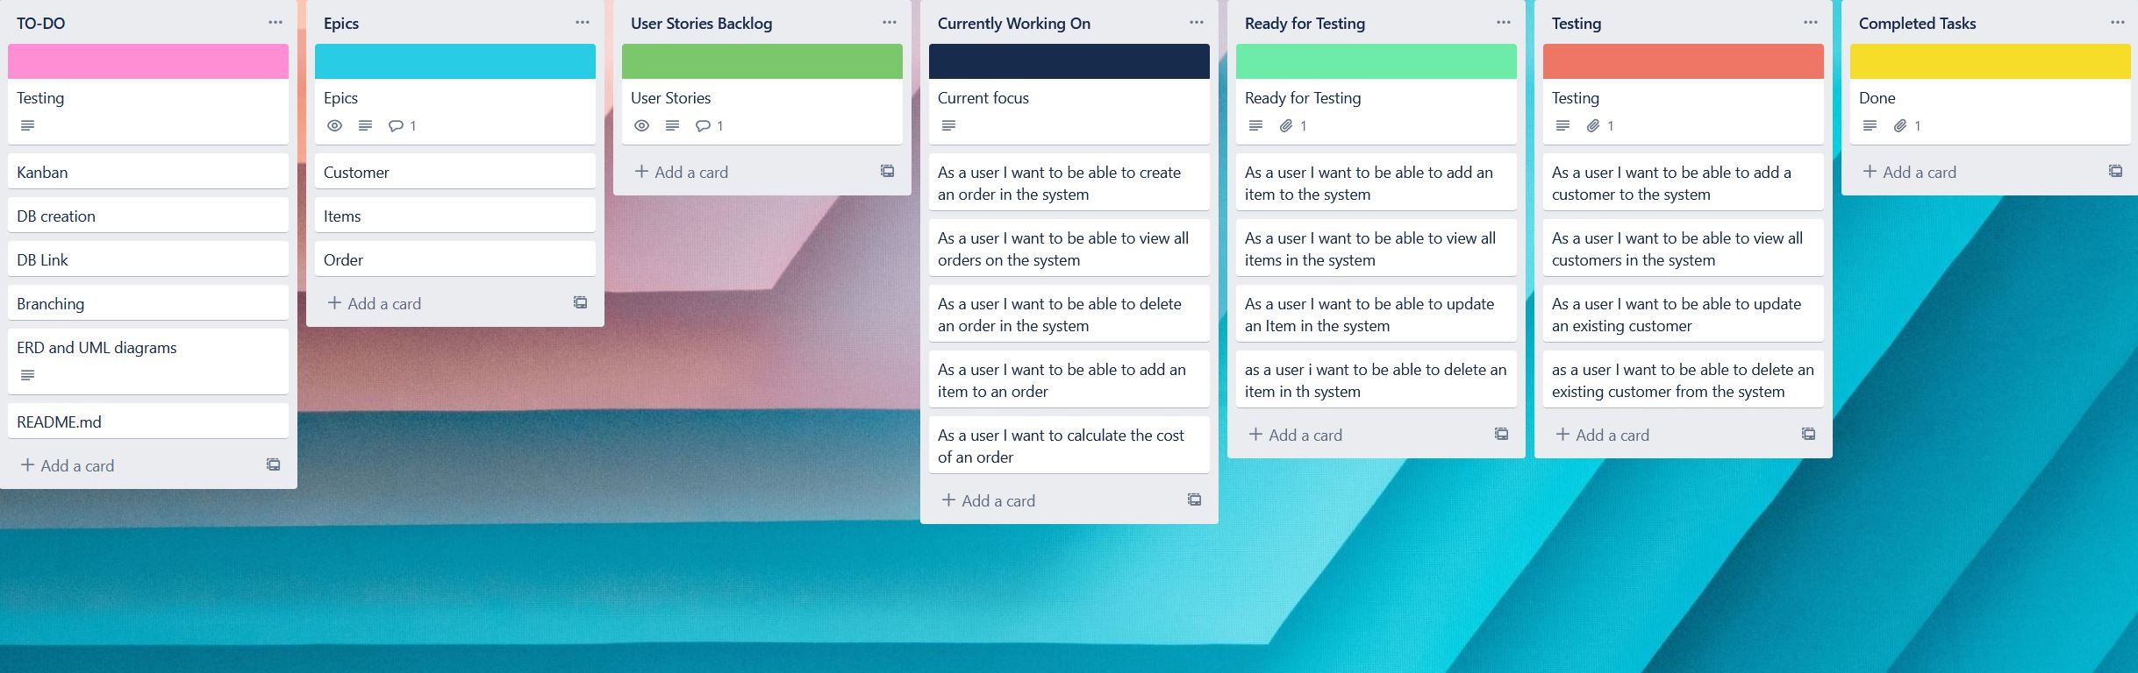
Project Management
Kanban Board – Trello

Slide 8
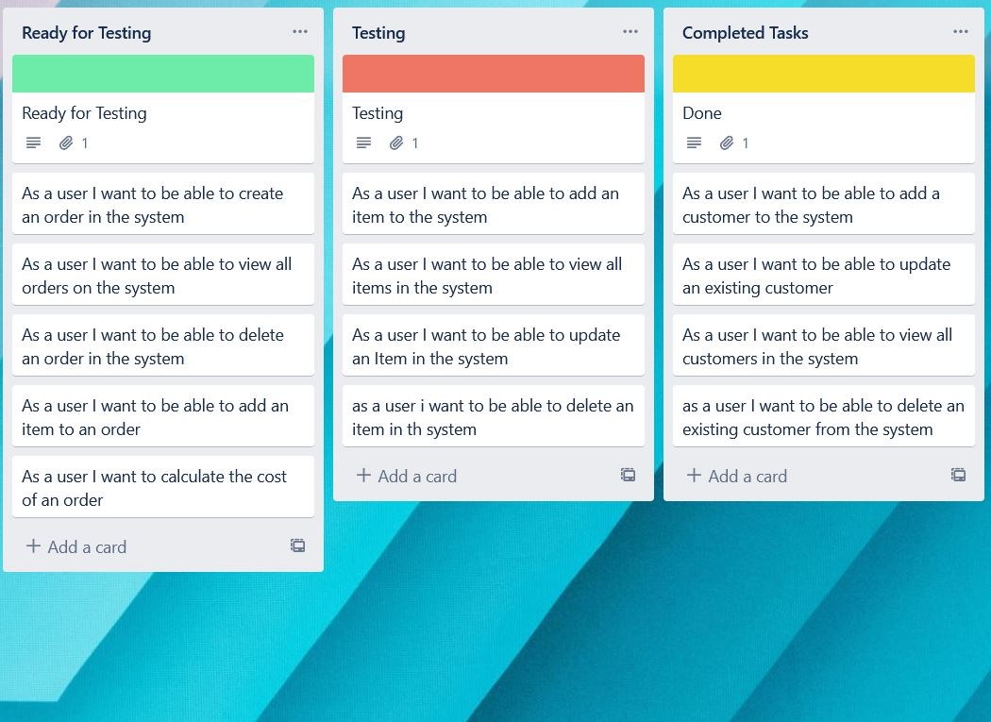
Project Management
Kanban Board – Trello

Slide 9
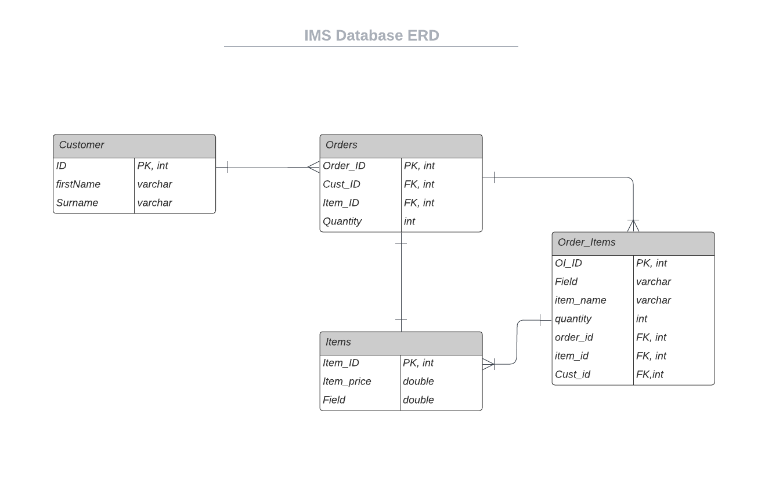
Project Management
Entity Relationship Diagrams – LucidChart

Slide 10
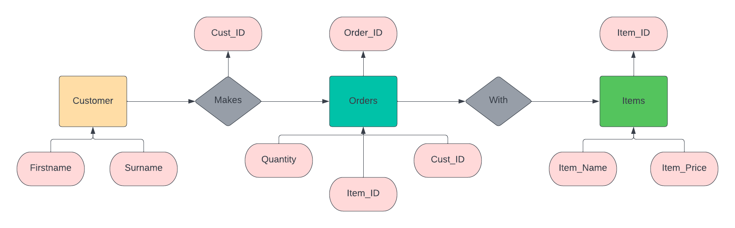
Project Management
Entity Relationship Diagrams – LucidChart

Slide 11
Project Management
MoSCoW prioritisation
Version Control – Git
Feature Branch Model

Slide 12
Product Demo
How a user would interact with the product
CRUD functionality
Code overview

Slide 13

Testing
JUnit
Mockito
63% Overall Testing coverage

Slide 14
Issues
Feature Branch Model
Testing
Maven Builds

Slide 15
Future Development
More functionality (Stock Control, Invoicing)
Graphical User Interface
Implementations with other applications (Shipping Controller)

Slide 16
Thanks for Watching
LinkedIn – Danyel Harrison
Teams
Email – danyel.harrison@qa.com
GitHub – github.com/danyelharrison

